Slide 1
Trees
Fall 2023
School of Software Engineering
South China University of Technology

Slide 2


Contents
Definitions of tree
Binary tree
AVL tree
Splay tree
B-tree

Slide 3
Splay Trees

Slide 4

Readings
Reading
Sections 4.5-4.7

Slide 5
Self adjusting Trees
Ordinary binary search trees have no balance conditions
what you get from insertion order is it
Balanced trees like AVL trees enforce a balance condition when nodes change
tree is always balanced after an insert or delete
Self-adjusting trees get reorganized over time as nodes are accessed
Tree adjusts after insert, delete, or find

Slide 6
Splay Trees
Splay trees are tree structures that:
Are not perfectly balanced all the time
Data most recently accessed is near the root. (principle of locality; 80-20 “rule”)
The procedure:
After node X is accessed, perform “splaying” operations to bring X to the root of the tree.
Do this in a way that leaves the tree more balanced as a whole

Slide 7
Splay Trees
How to perform splaying?
A Simple Idea
to perform single rotations, bottom up
Now K1 is accessed, perform a single rotation

Slide 8
Splay Trees
How to perform splaying?
A Simple Idea
to perform single rotations, bottom up
Then, continue to perform a single rotation

Slide 9
Splay Trees
How to perform splaying?
A Simple Idea
to perform single rotations, bottom up
Then, continue…

Slide 10
Splay Trees
How to perform splaying?
A Simple Idea
to perform single rotations, bottom up
continue …

Slide 11
Splay Trees
How to perform splaying?
A Simple Idea
to perform single rotations, bottom up
Now k1 reach the root. Future accesses on k1 are cheaper.
But pushing other node deep, ex. k3.

Slide 12
Splay Trees
How to perform splaying?
A Simple Idea
to perform single rotations, bottom up
This strategy is not good enough
A sequence of M operations requires Ω(N•M)
Consider the tree formed by inserting keys N ,N-1,…,1, into an initially empty tree

Slide 13
Splay Trees
Then, access 1
Then, access 2
For n nodes, total num of rotations is
(n - 1) + { (n - 1) + (n - 2) + … + 1 }= (n² +n-2)/2 , i.e. Ω(n²).
Each operation requiring O (n) time.
Then, access 5
Then, access 4
Then, access 3

Slide 14
Splay Trees
Goal:
Principle of locality
An O(logN) amortized cost per operation
How to perform splaying?
Another strategy to perform double rotations (splay)

Slide 15
Splay Trees
Terminology
Let X be a non-root node with ≥ 2 ancestors.
P is its parent node.
G is its grandparent node.
G
G
G
G
P
P
P
P
X
X
X
X

Slide 16
Zig-Zig（一字型） and
Zig-Zag（之字形）
Parent and grandparent in same direction.
Parent and grandparent in different directions.
zig-zig
4
G
G
5
P
5
1
P
zig-zag
X
2
X

Slide 17
Splay Trees
Splay Tree Operations:
parent
element
1. Helpful if nodes contain a parent pointer.
left
right
2. When X is accessed, apply one of six rotation routines.
Single Rotations (X has a P (the root) but no G)
ZigFromLeft, ZigFromRight
Double Rotations (X has both a P and a G)
ZigZigFromLeft, ZigZigFromRight
ZigZagFromLeft, ZigZagFromRight

Slide 18
Zig at depth 1 (single rotation)
“Zig” is just a single rotation, as in an AVL tree
Let R be the node that was accessed (e.g. using Find)
ZigFromLeft moves R to the top →faster access next time
root
ZigFromLeft

Slide 19
Zig at depth 1 (single rotation)
Suppose Q is now accessed using Find
ZigFromRight moves Q back to the top
root
ZigFromRight

Slide 20
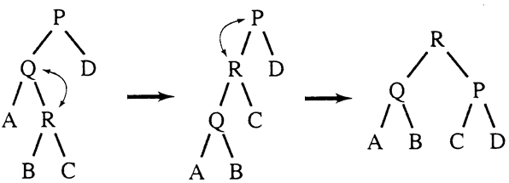
Zig-Zag operation
“Zig-Zag” consists of two rotations of the opposite direction (assume R is the node that was accessed)
(ZigFromRight)
(ZigFromLeft)
ZigZagFromLeft

Slide 21
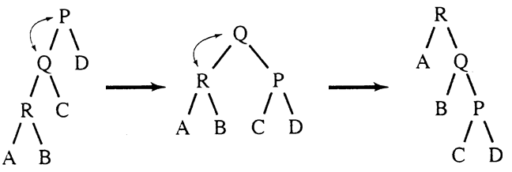
Zig-Zig operation
“Zig-Zig” consists of two single rotations of the same direction (R is the node that was accessed)
(ZigFromLeft)
(ZigFromLeft)
ZigZigFromLeft

Slide 22
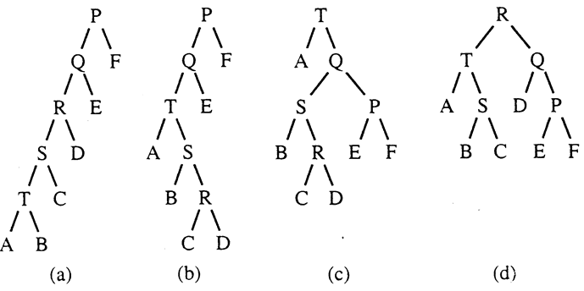
Decreasing depth - "autobalance"
Find(T)
Find(R)
splaying not only moves the accessed node to the root,
but also has the effect of roughly halving the depth of most nodes on the access path

Slide 23
Splay Tree Insert and Delete
Insert x
Insert x as normal then splay x to root.
Delete x
Splay x to root and remove it. (note: the node does not have to be a leaf or single child node like in BST delete.) Two trees remain, right subtree and left subtree.
Splay the max in the left subtree to the root
Attach the right subtree to the new root of the left subtree.

Slide 24
Example Insert
Inserting in order 1,2,3,…,8
Without self-adjustment
1
2
3
O(n²) time for n Insert
4
5
6
7
8

Slide 25
Example Insert
Inserting in order 1,2,3,…,8
With self-adjustment
Each Insert takes O(1) time therefore O(n) time for n Insert!!
1
1
ZigFromRight
2
2
1
2
3
ZigFromRight
1
3
2
1
4
3
3
ZigFromRight
2
4
2
1
1

Slide 26
Example Deletion
10
8
5
15
splay
(Zig-Zag)
5
10
2
8
13
20
2
6
9
15
6
9
13
20
remove
6
Splay (zig)
attach
5
10
5
10
2
9
15
2
6
9
15
13
20
13
20

Slide 27
Analysis of Splay Trees
Splay trees tend to be balanced
M operations takes time O(M log N) for M > N operations on N items. (proof is difficult)
Amortized O(log n) time.
Splay trees have good “locality” properties
Recently accessed items are near the root of the tree.
Items near an accessed one are pulled toward the root.

Slide 28
Homework
Homework 3-3
Textbook exercises 4.27, 4.28

Slide 29
B-Trees

Slide 30
Beyond Binary Search Trees: Multi-Way Trees
Example: B-tree of order 3 has 2 or 3 children per node
e.g. search for 8
13:-
6:11
17:-
3 4
6 7 8
11 12
13 14
17 18

Slide 31
B-Trees
B-Trees are multi-way search trees commonly used in database systems or other applications where data is stored externally on disks and keeping the tree shallow is important.

Slide 32
B-Trees
A B-Tree of order M has the following properties:
The root is either a leaf or has between 2 and M children.
All nonleaf nodes (except the root) have between ⎡M/2⎤ and M children.
All leaves are at the same depth.
All data records are stored at the leaves.
Internal nodes have “keys” guiding to the leaves.
Leaves store between ⎡L/2⎤ and L data records, where L can be equal to M (default) or can be different.

Slide 33
B-Tree Details
Each (non-leaf) internal node of a B-tree has:
Between ⎡M/2⎤ and M children.
up to M-1 keys k₁ < k₂ < ... < k_{M-1}
k₁
. . .
k_{i-1}
k_{i}
. . .
k_{M-1}
Keys are ordered so that:
k₁ < k₂ < ... < k_{M-1}

Slide 34
Properties of B-Trees
k₁
. . .
k_{i-1}
k_{i}
. . .
k_{M-1}
T₁
. . .
T_{i}
. . .
T_{M}
Children of each internal node are "between" the items in that node.
Suppose subtree T_{i} is the ith child of the node:
- All keys in T_{i} must be between keys k_{i-1} and k_{i} , i.e. k_{i-1} ≤ T_{i} < k_{i} , k_{i-1} is the smallest key in T_{i}
- All keys in first subtree T₁ < k₁
- All keys in last subtree T_{M} ≥ k_{M-1}

Slide 35
Properties of B-Trees
B-Tree Nonleaf Node
P[0] | K[0] | … | K[i-1] | P[i] | K[i] | … | K[q-1] | P[q]
x
y
z
x < K[0]
K[i-1]≤y<K[i]
K[q-1] ≤ z
| 4 | | 8 |
The Ks are keys
The Ps are pointers to subtrees
x<4 4≤x<8 8 ≤x

Slide 36
Properties of B-Trees
B-Tree leaf Node (B+tree)
k[0] | R[0] | … | k[i-1] | R[i-1] | … | K[q] | R[q] | Next
The Ks are keys (assume unique).
The Rs are pointers to records with those keys.
The Next link points to the next leaf in key order (B+-tree).
75 89 95
103 115
data record
95 Jones Mark 19 4

Slide 37
Searching in B-trees
B-tree of order 3: also known as 2-3 tree (2 to 3 children)
Examples: Search for 9, 14, 12
Note: If leaf nodes are connected as a Linked List, B-tree is called a B+ tree – Allows sorted list to be accessed easily
13:-
6:11
17:-
3 4
6 7 8
11 12
13 14
17 18

Slide 38
Searching in B-trees
Searching a B-Tree T for a Key Value K
Find(ElementType K, Btree T){
B = T;
while (B is not a leaf){
find the Pi in node B that points to the proper subtree that K will be in;
B = Pi;
}
/* Now we’re at a leaf */
if key K is the jth key in leaf B,
use the jth record pointer to find the
associated record;
else /* K is not in leaf B */ report failure;
}

Slide 39
Inserting into B-Trees
Insert X: Do a Find on X and find appropriate leaf node
If leaf node is not full, fill in empty slot with X
E.g. Insert 5
If leaf node is full, split leaf node and adjust parents up to root node
E.g. Insert 9
Assume M=L=3,
so (6 7 8) is full.
13:-
6:11
17:-
3 4
6 7 8
11 12
13 14
17 18

Slide 40
Inserting into B-Trees
// Inserting a New Key in a B-Tree of Order M (and L=M)
Insert(ElementType K, Btree B)
{
find the leaf node LB of B in which K belongs;
if notfull(LB) insert K into LB;
else {
split LB into two nodes LB and LB2 with
j = ⎣(L+1)/2⎦ keys in LB and the rest in LB2;
if ( IsNull(Parent(LB)) )
CreateNewRoot(LB, K[j+1], LB2);
else
InsertInternal(Parent(LB), K[j+1], LB2);
}
}
LB
LB2
K[1] R[1] . . . K[j] R[j]
K[j+1] R[j+1] . . . K[M+1] R[M+1]

Slide 41
Inserting into B-Trees
// Inserting a (Key,Ptr) Pair into an Internal Node
If the node is not full, insert them in the proper
place and return.
If the node is already full (M pointers, M-1 keys),
find the place for the new pair and split
the adjusted (Key,Ptr) sequence into two
internal nodes with
j = ⎣(M+1)/2⎦ pointers and j-1 keys in the first,
the next key is inserted in the node’s parent,
and the rest in the second of the new pair.

Slide 42
Example of Insertions
Insertions into a B+tree with M=3, L=2
Insertion Sequence: 9, 5, 1, 7, 3,12
1
2
3
4
9
5 | 9
| 5 |
| 5 | | 7 |
1 | |
5 | 9 |
1 | |
5 | |
7 | 9 |
6
5
| 7 |
| 5 | | 7 |
| 5 |
| 9 |
1 | 3 |
5 | |
7 | 9 |
1 | 3 |
5 | |
7 | |
9 | 12 |

Slide 43
Deleting From B-Trees
Delete X : Do a find and remove from leaf
Leaf underflows – borrow from a neighbor
E.g. 11
Leaf underflows and can’t borrow – merge nodes, delete parent
E.g. 17
13:-
6:11
17:-
3 4
6 7 8
11 12
13 14
17 18

Slide 44
Run Time Analysis of B-Tree Operations
For a B-Tree of order M
Each internal node has up to M-1 keys to search
Each internal node has between ⎡M/2⎤ and M children
Depth of B-Tree storing N items is O(log _{⎡M/2⎤} N)
Find: Run time is:
O(log M) to binary search which branch to take at each node. But M is small compared to N.
Total time to find an item is O(depth*log M) = O(log N)

Slide 45
Run Time Analysis of B-Tree Operations
How Do We Select the Order M?
In internal memory, small orders, like 3 or 4 are fine.
On disk, we have to worry about the number of disk accesses to search the index and get to the proper leaf.
Rule: Choose the largest M so that an internal
node can fit into one physical block of the disk.
This leads to typical M’s between 32 and 256
And keeps the trees as shallow as possible.

Slide 46
Summary of Search Trees
Problem with Binary Search Trees
Must keep tree balanced to allow fast access to stored items
AVL trees: Insert/Delete operations keep tree balanced
Splay trees: Repeated Find operations produce balanced trees
Multi-way search trees (e.g. B-Trees):
More than two children per node allows shallow trees; all leaves are at the same depth.
Keeping tree balanced at all times.
Excellent for indexes in database systems.

Slide 47
Homework
Homework 3-4
Show the updated B+-Tree with order 4 that results from inserting the records U and R in order.
Assume that the leaf nodes are capable of storing up to 3 records
D | M | S
A | B | C
D | G | I
M | N | P
S | T | W

